Slide 1
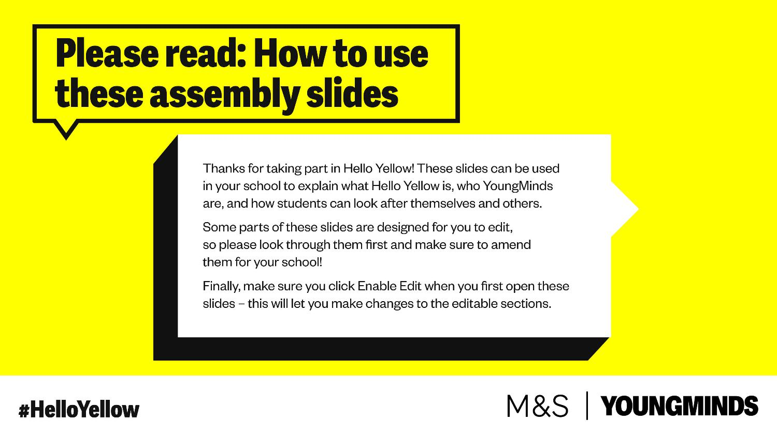

Slide 2


Slide 3

Wearing something yellow (if you have it), joining in with activities in
including talking about Mental Health and our 10 a day for good mental
health

Slide 4


Slide 5
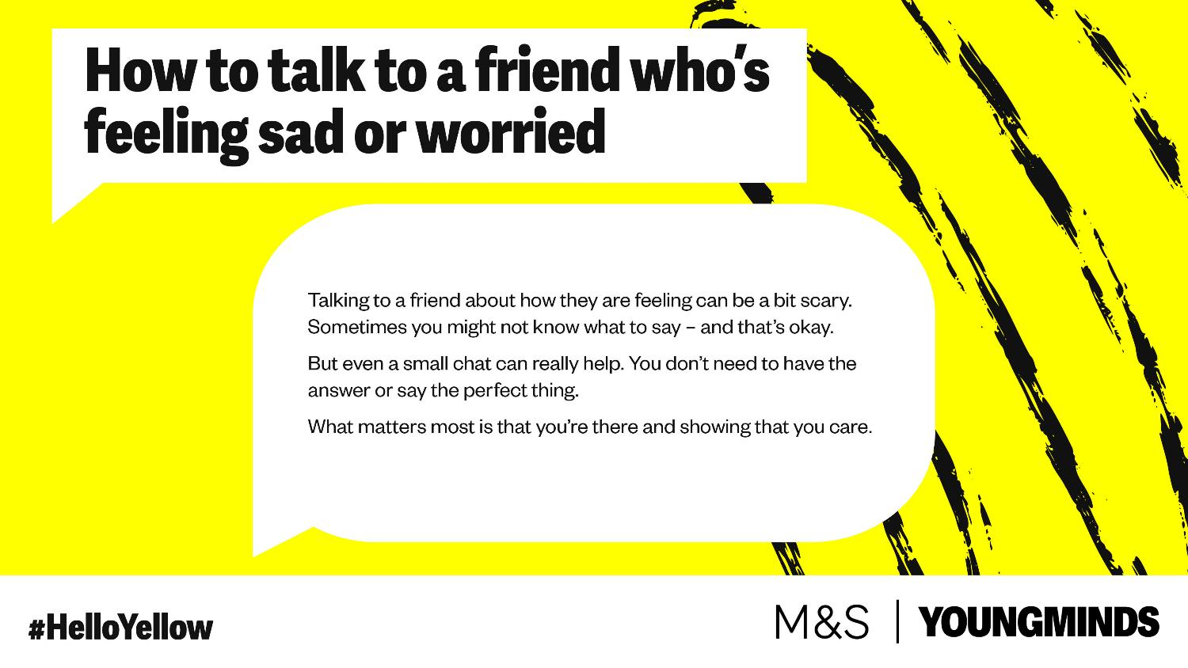

Slide 6
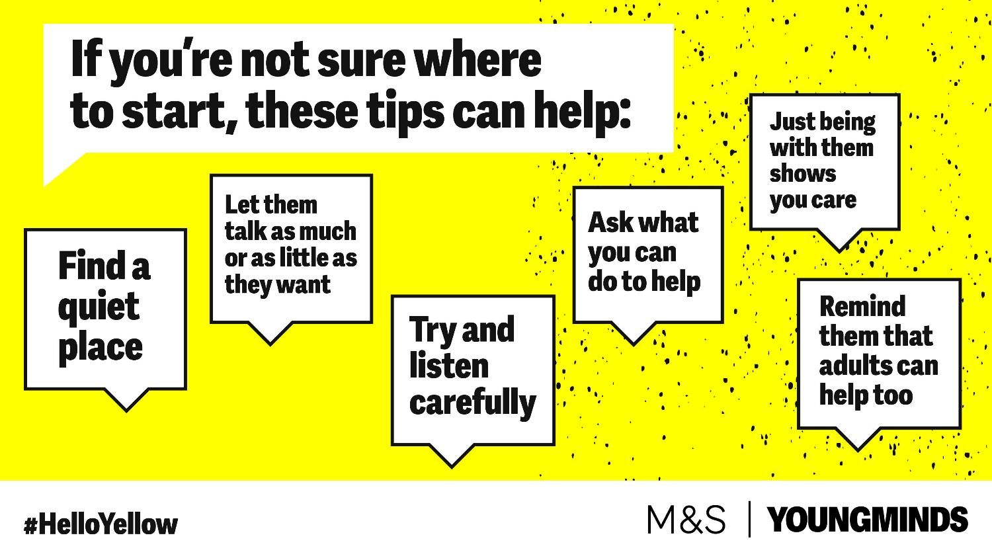

Slide 7
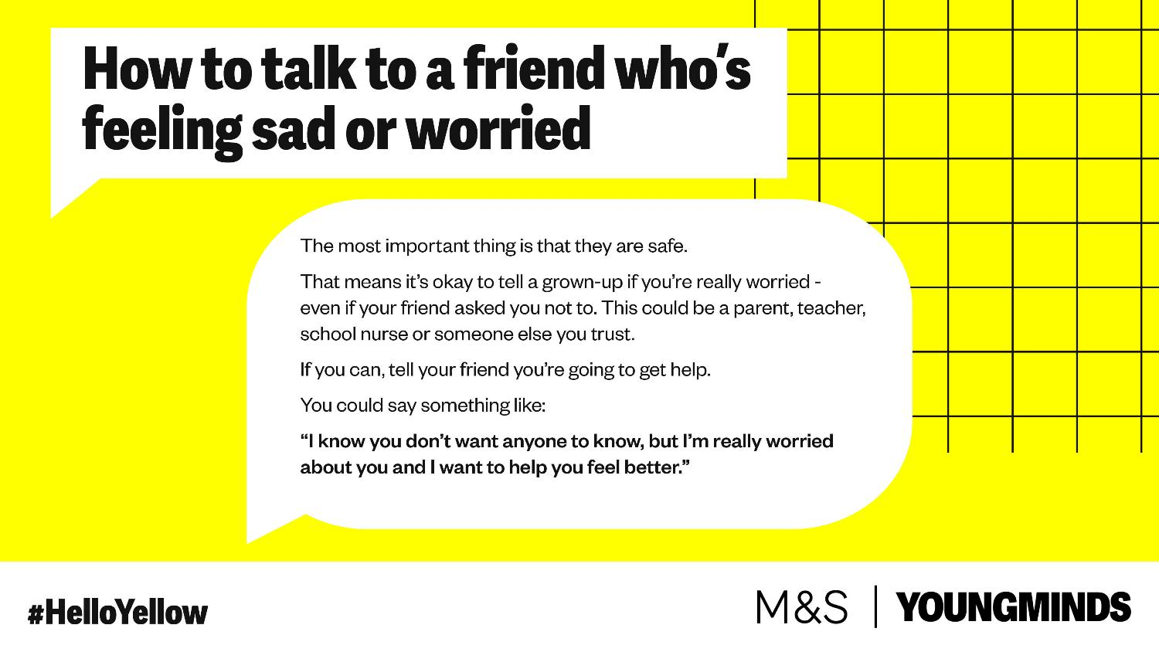

Slide 8
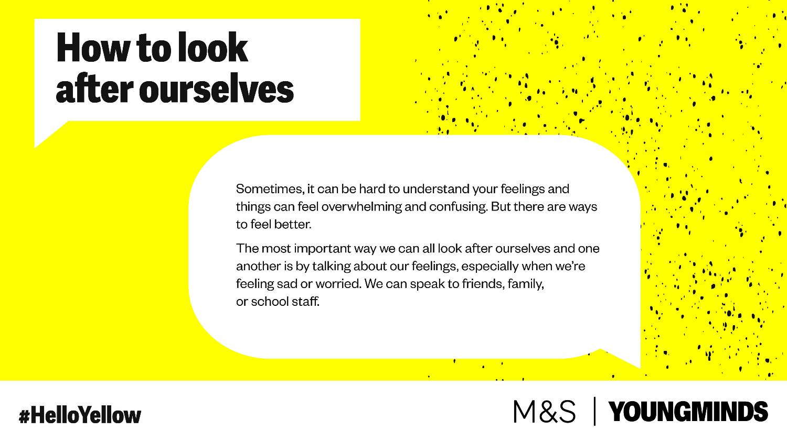

Slide 9
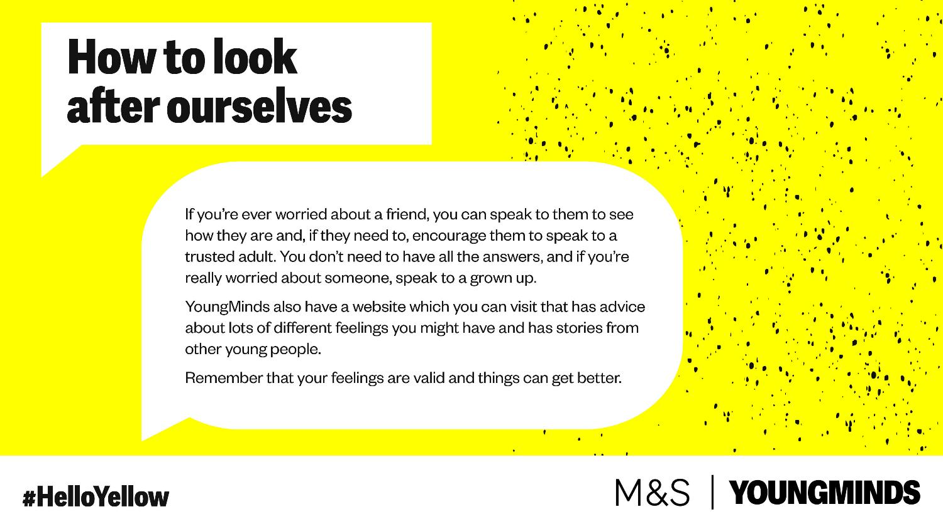

Slide 10
The best way to get help in our school is to let a trusted adult know that you need some support, this could be:
One of your teachers
A lunch time assistant
Mrs Strachan
Mrs Cahill
Mrs Warren
A member of the office team

Slide 11


